Slide 1
Python Tutorial Data Types
S1 MCA

Slide 2
Python Collections (Arrays)
There are four collection data types in the Python programming language:
List is a collection which is ordered and changeable. Allows duplicate members.
Tuple is a collection which is ordered and unchangeable. Allows duplicate members.
Set is a collection which is unordered, unchangeable*, and unindexed. No duplicate members.
Dictionary is a collection which is ordered** and changeable. No duplicate members.

Slide 3
Python Lists
Lists are used to store multiple items in a single variable.
Lists are one of 4 built-in data types in Python used to store collections of data, the other 3 are Tuple, Set, and Dictionary, all with different qualities and usage.
Lists are created using square brackets:
Create a List:
thislist = ["apple", "banana", "cherry"] print(thislist)

Slide 4
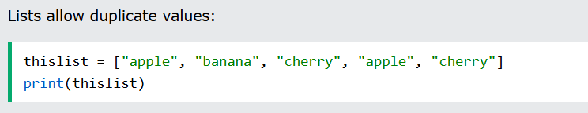
List Items
List items are ordered, changeable, and allow duplicate values.
List items are indexed, the first item has index [0], the second item has index [1] etc.
Ordered
When we say that lists are ordered, it means that the items have a defined order, and that order will not change.
If you add new items to a list, the new items will be placed at the end of the list.
Changeable
The list is changeable, meaning that we can change, add, and remove items in a list after it has been created.
Allow Duplicates
Since lists are indexed, lists can have items with the same value:

Slide 5
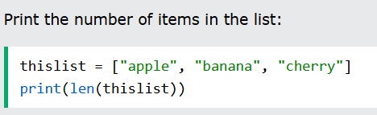
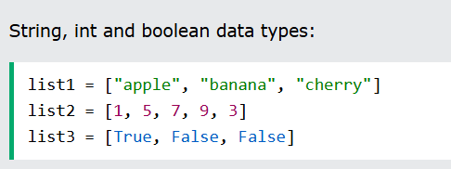
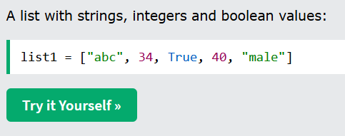
List Length
To determine how many items a list has, use the len() function:
List Items - Data Types
List items can be of any data type:
A list can contain different data types:

Slide 6
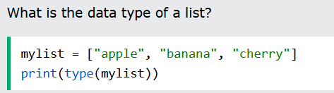
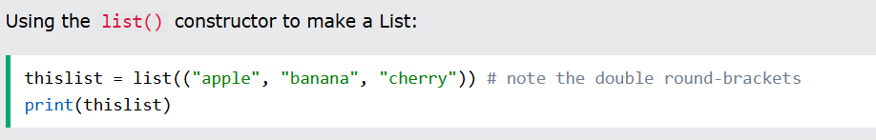
type()
From Python's perspective, lists are defined as objects with the data type 'list’:
The list() Constructor
It is also possible to use the list() constructor when creating a new list.

Slide 7
Python - Access List Items
List items are indexed and you can access them by referring to the index number:
>>>thislist = ["apple", "banana", "cherry"] print(thislist[1])
→ will print second item of the list
Negative Indexing
Negative indexing means start from the end
-1 refers to the last item, -2 refers to the second last item etc.
>>>thislist = ["apple", "banana", "cherry"] print(thislist[-1])
→Print the last Item of the list

Slide 8
Range of Indexes
You can specify a range of indexes by specifying where to start and where to end the range.
>>>thislist = ["apple", "banana", "cherry", "orange", "kiwi", "melon", "mango"] print(thislist[2:5])
→Return the third, fourth, and fifth item:
→The search will start at index 2 (included) and end at index 5(not included).
By leaving out the start value, the range will start at the first item:
>>>thislist = ["apple", "banana", "cherry", "orange", "kiwi", "melon", "mango"] print(thislist[:4])
→This example returns the items from the beginning to, but NOT including, "kiwi":

Slide 9
By leaving out the end value, the range will go on to the end of the list:
>>>thislist = ["apple", "banana", "cherry", "orange", "kiwi", "melon", "mango"] print(thislist[2:])
→This example returns the items from "cherry" to the end:
Range of Negative Indexes
Specify negative indexes if you want to start the search from the end of the list:
>>>thislist = ["apple", "banana", "cherry", "orange", "kiwi", "melon", "mango"] print(thislist[-4:-1])
→returns the items from "orange" (-4) to, but NOT including "mango" (-1):

Slide 10
Check if Item Exists
To determine if a specified item is present in a list use the in keyword:
>>>thislist = ["apple", "banana", "cherry"] if "apple" in thislist: print("Yes, 'apple' is in the fruits list")
→Check if "apple" is present in the list:

Slide 11
Python - Change List Items
Change Item Value
To change the value of a specific item, refer to the index number
>>> thislist = ["apple", "banana", "cherry"] thislist[1] = "blackcurrant" print(thislist)
→ Change the second item:
Change a Range of Item Values
To change the value of items within a specific range, define a list with the new values, and refer to the range of index numbers where you want to insert the new values

Slide 12
>>> thislist = ["apple", "banana", "cherry", "orange", "kiwi", "mango"]
thislist[1:3] = ["blackcurrant", "watermelon"]
print(thislist)
→ Change the values "banana" and "cherry" with the values "blackcurrant" and "watermelon":
If you insert more items than you replace, the new items will be inserted where you specified, and the remaining items will move accordingly:
>>> thislist = ["apple", "banana", "cherry"] thislist[1:2] = ["blackcurrant", "watermelon"] print(thislist)
→output:['apple', 'blackcurrant', 'watermelon', 'cherry']
→The length of the list will change when the number of items inserted does not match the number of items replaced.

Slide 13
If you insert less items than you replace, the new items will be inserted where you specified, and the remaining items will move accordingly
>>> thislist = ["apple", "banana", "cherry"] thislist[1:3] = ["watermelon"] print(thislist)
Change the second and third value by replacing it with one value:
['apple', 'watermelon’]

Slide 14
Python - Add List Items
Insert Items
To insert a new list item, without replacing any of the existing values, we can use the insert() method.
The insert() method inserts an item at the specified index
>>> thislist = ["apple", "banana", "cherry"] thislist.insert(2, "watermelon") print(thislist)
As a result of the example above, the list will now contain 4 items.
Output:['apple', 'banana', 'watermelon', 'cherry’]

Slide 15
Append Items
To add an item to the end of the list, use the append() method
>>> thislist = ["apple", "banana", "cherry"] thislist.append("orange") print(thislist)
Extend List
To append elements from another list to the current list, use the extend() method.
>>> thislist = ["apple", "banana", "cherry"] tropical = ["mango", "pineapple", "papaya"] thislist.extend(tropical) print(thislist)
→Output:['apple', 'banana', 'cherry', 'mango', 'pineapple', 'papaya']

Slide 16
Python - Remove List Items
Remove Specified Item
The remove() method removes the specified item.
>>> thislist = ["apple", "banana", "cherry"] thislist.remove("banana") print(thislist)
→Output:['apple', 'cherry']
→If there are more than one item with the specified value, the remove() method removes the first occurrence:

Slide 17
>>> thislist = ["apple", "banana", "cherry", "banana", "kiwi"] thislist.remove("banana") print(thislist)
output:['apple', 'cherry', 'banana', 'kiwi’]
Remove Specified Index
The pop() method removes the specified index.
>>> thislist = ["apple", "banana", "cherry"] thislist.pop(1) print(thislist)
→Output:['apple', 'cherry']
If you do not specify the index, the pop() method removes the last item.

Slide 18
If you do not specify the index, the pop() method removes the last item.
>>> thislist = ["apple", "banana", "cherry"] thislist.pop() print(thislist)
→Output:['apple', 'banana’]
The del keyword also removes the specified index:
>>> thislist = ["apple", "banana", "cherry"] del thislist[0] print(thislist)
Output : ['banana', 'cherry’]
The del keyword can also delete the list completely
>>> thislist = ["apple", "banana", "cherry"] del thislist

Slide 19
Clear the List
The clear() method empties the list.
The list still remains, but it has no content.
>>> thislist = ["apple", "banana", "cherry"] thislist.clear() print(thislist)

Slide 20
Python - Loop Lists
You can loop through the list items by using a for loop:
>>>thislist = ["apple", "banana", "cherry"] for x in thislist: print(x)
Loop Through the Index Numbers
You can also loop through the list items by referring to their index number.
Use the range() and len() functions to create a suitable iterable.
>>>thislist = ["apple", "banana", "cherry"] for i in range(len(thislist)): print(thislist[i])

Slide 21
Using a While Loop
You can loop through the list items by using a while loop.
Use the len() function to determine the length of the list, then start at 0 and loop your way through the list items by referring to their indexes.
Remember to increase the index by 1 after each iteration.
>>>thislist = ["apple", "banana", "cherry"]
i = 0
while i < len(thislist):
print(thislist[i])
I = i + 1

Slide 22
Python - List Comprehension
List comprehension offers a shorter syntax when you want to create a new list based on the values of an existing list.
Without list comprehension you will have to write a for statement with a conditional test inside:
fruits = ["apple", "banana", "cherry", "kiwi", "mango"]
newlist = []
for x in fruits:
if "a" in x:
newlist.append(x)
print(newlist)

Slide 23
With list comprehension you can do all that with only one line of code:
Syntax:
newlist = [expression for item in iterable if condition == True]
item – a variable that takes each value from iterable.
expression – what you want to put into the new list (often item, but can also be something transformed like item.upper()).
if condition == True – a filter: only items where the condition is True are included.
You can shorten if condition == True to just if condition.

Slide 24
>>> fruits = ["apple", "banana", "cherry", "kiwi", "mango"] newlist = [x.upper() for x in fruits if "a" in x] print(newlist)
Output: ['APPLE', 'BANANA', 'MANGO’]
You can use the range() function to create an iterable:
newlist = [x for x in range(10)]

Slide 25
Sort List
List objects have a sort() method that will sort the list alphanumerically, ascending, by default
>>> thislist = ["orange", "mango", "kiwi", "pineapple", "banana"] thislist.sort() print(thislist)
>>> thislist = [100, 50, 65, 82, 23] thislist.sort() print(thislist)

Slide 26
Sort Descending
To sort descending, use the keyword argument reverse = True
>>> thislist = ["orange", "mango", "kiwi", "pineapple", "banana"] thislist.sort(reverse = True) print(thislist)
>>> thislist = [100, 50, 65, 82, 23] thislist.sort(reverse = True) print(thislist)

Slide 27
Customize Sort Function
You can also customize your own function by using the keyword argument key = function.
>>> def myfunc(n):
return abs(n - 50)
thislist = [100, 50, 65, 82, 23]
thislist.sort(key = myfunc)
print(thislist)

Slide 28
Case Insensitive Sort
By default the sort() method is case sensitive, resulting in all capital letters being sorted before lower case letters:
>>> thislist = ["banana", "Orange", "Kiwi", "cherry"] thislist.sort() print(thislist)
>>> thislist = ["banana", "Orange", "Kiwi", "cherry"] thislist.sort(key = str.lower) print(thislist)

Slide 29
Reverse Order
The reverse() method reverses the current sorting order of the elements.
>>> thislist = ["banana", "Orange", "Kiwi", "cherry"] thislist.reverse() print(thislist)
→ Output :['cherry', 'Kiwi', 'Orange', 'banana']

Slide 30
String and number together
>>> thislist = ["orange", "mango", "kiwi", "pineapple", 1]
thislist = [str(item) for item in thislist]
thislist.sort()
print(thislist)
→ Output :['1', 'kiwi', 'mango', 'orange', 'pineapple']

Slide 31
>>> thislist = ["orange", "mango", "kiwi", "pineapple", 1]
strings = sorted([x for x in thislist if isinstance(x, str)])
numbers = sorted([x for x in thislist if isinstance(x, int)])
sorted_list = numbers + strings
print(sorted_list)
→ Output : [1, 'kiwi', 'mango', 'orange', 'pineapple']

Slide 32
Copy a List
You cannot copy a list simply by typing list2 = list1,
because: list2 will only be a reference to list1,
and changes made in list1 will automatically also be made in list2.
You can use the built-in List method copy() to copy a list.
>>> thislist = ["apple", "banana", "cherry"] mylist = thislist.copy() print(mylist)

Slide 33
Use the list() method
Another way to make a copy is to use the built-in method list().
>>> thislist = ["apple", "banana", "cherry"] mylist = list(thislist) print(mylist)
Use the slice Operator
You can also make a copy of a list by using the : (slice) operator.
>>> thislist = ["apple", "banana", "cherry"] mylist = thislist[:] print(mylist)

Slide 34
Join Two Lists
There are several ways to join, or concatenate, two or more lists in Python.
One of the easiest ways are by using the + operator.
>>> list1 = ["a", "b", "c"] list2 = [1, 2, 3] list3 = list1 + list2 print(list3)

Slide 35
Another way to join two lists is by appending all the items from list2 into list1, one by one:
>>> list1 = ["a", "b" , "c"] list2 = [1, 2, 3] for x in list2: list1.append(x) print(list1)
you can use the extend() method, where the purpose is to add elements from one list to another list
>>> list1.extend(list2) print(list1)

Slide 36
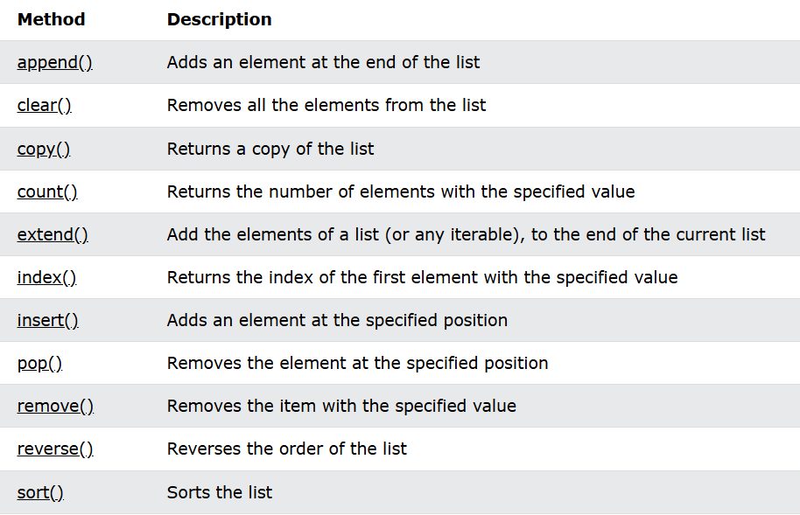
List Methods

Slide 37


